Slide 1

Quantum Computing & Its Application to Industrial Ammonia Production
James Riley Dorough

Slide 2
Overview
Defining the Problem
Current Ammonia Production Methods
Functionality of Quantum Computing
Application of Quantum on the Ammonia Problem
Perspective Outcomes
Conclusion
2

Slide 3
Defining the Problem
Ammonia is the second highest produced chemical commodity¹
Production is a highly resource intensive process
>90% of ammonia is produced from fossil fuels though the Haber Process¹
1.2% of the world’s energy is used for ammonia production¹
Modern methods return 20-21% of ammonia from output gasses²
Ammonia is required to produce fertilizer
The primary source for the global food supply
As population increases, a method to replace the Haber process may be required
3

Slide 4
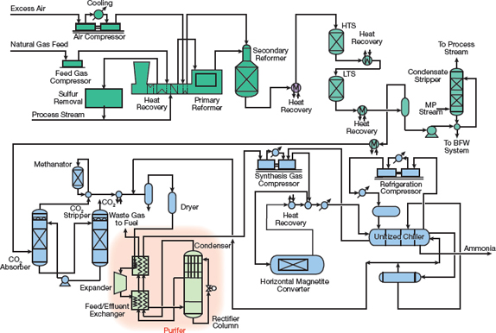
Current Ammonia Production Methods
Key issue is the resource requirement and inefficient output
Utilities have been designed to reuse waste energy and material
Recycles heat exhaust
Sends material back through the input in a cycle
4

Slide 5
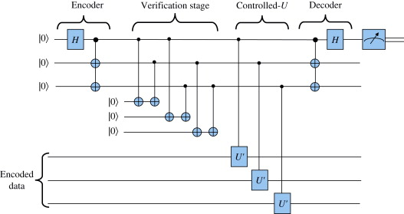

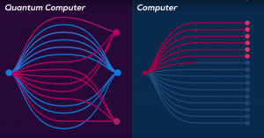
Functionality of Quantum Computing
Operate on principles of quantum mechanics
Uses qbits to store information
Qbits remain in a superposition between 0 & 1 until observed
Quantum computers operate with amplitudes as coefficients of probability
5

Slide 6
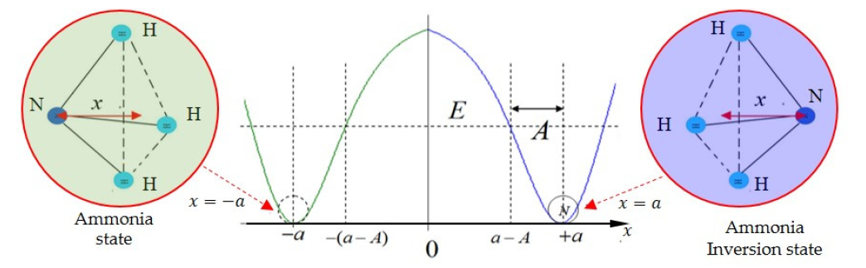
Application of Quantum on the Ammonia Problem
Nature produces ammonia through bacteria without excessive heat
Researchers are not fully sure how to replicate this process in industry
Quantum Tunneling observed in ammonia
6

Slide 7
Perspective Outcomes
Quantum computing applied to researching events in nature can lead to an understanding of ammonia optimization
Optimizing the production process can press humanity ahead of food supply needs expected with a constant rise in population
Understood applications of quantum computing drive additional research
7

Slide 8

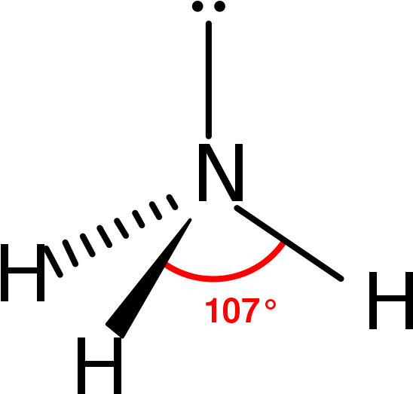
Conclusion
Defining the Problem
Current Ammonia Production Methods
Functionality of Quantum Computing
Application of Quantum on the Ammonia Problem
Perspective Outcomes
8

Slide 9
Refrences
Ghavam, S., Vahdati, M., Wilson, I. A. G., & Styring, P. (2021). Sustainable Ammonia Production Processes. Frontiers in Energy Research, 9. https://www.frontiersin.org/articles/10.3389/fenrg.2021.580808/full
Introduction To Ammonia Production, V., & Introduction To Ammonia Production, J. (2016). Introduction to Ammonia Production. Introduction to Ammonia Production, 69–75. https://www.aiche.org/resources/publications/cep/2016/september/introduction-ammonia-production

